Slide 1
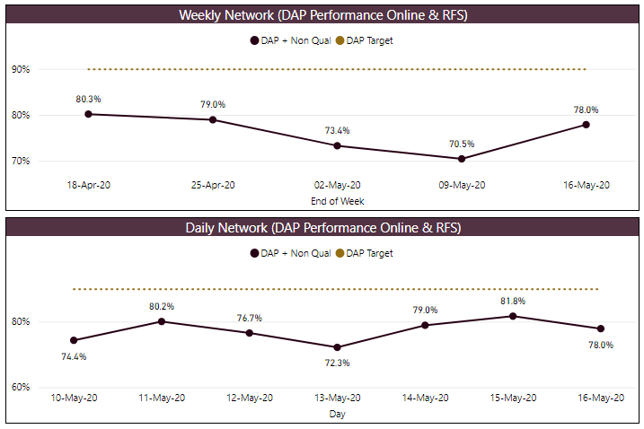
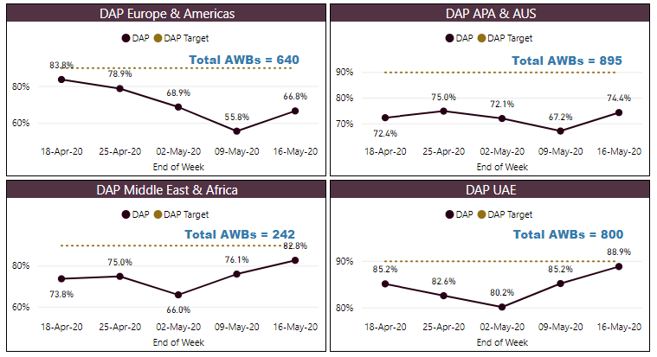
DELIVERED AS PROMISED
Network Actuals
Regional Actuals
DAP = “Deliver As Promised” – NFD on time (system issues not counted as failures to Customer)
RFS = “Road Feeder Service” – Stations with trucking contracts (Europe & US)
DAP target is 90% by end of 2020
Actions | Initiatives | Escalations
Last week DAP (78.0%), a increase of 7.5% from the previous period.
At the Regional level: EUR & AME (+11.0%), ME & AFR (+6.7%), APA & AUS (+7.2%) and UAE (+4.7%)
DAP YTD is 84.1%

Slide 2
DELIVERED AS PROMISED | BACKGROUND INFO
No Messages Failures for DAP
Hello World
Late Event Failures for DAP
Non Qual. Shipments Passing Op NFD
Hello World
No FSU Received (GHA Issue)
FSU Received (System Issue)
Notes for Week
Hello World
Hello World

Slide 3
DELIVERED AS PROMISED | FAILURE BREAKDOWN

Slide 4
